Slide 1
FIT2095
e-Business software technologies
Week 8 - Workshop Quiz
3 Questions

Slide 2
Question 1 (4+4=8) marks
List two advantages of TypeScript over JavaScript.
By an example, show the difference between property binding and event binding?

Slide 3

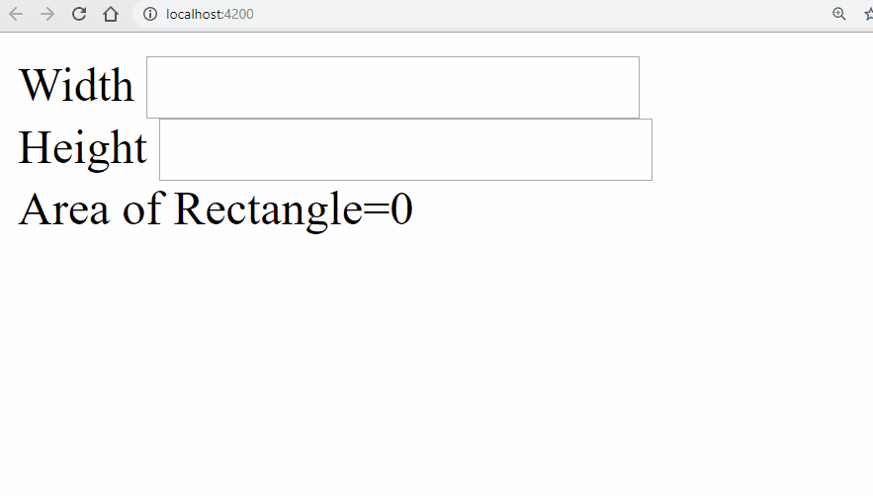
Question 2 (15) Marks
Write the simplest Angular code that is sufficient to produce the following output.
Start the Slide show
Note: More is less

Slide 4
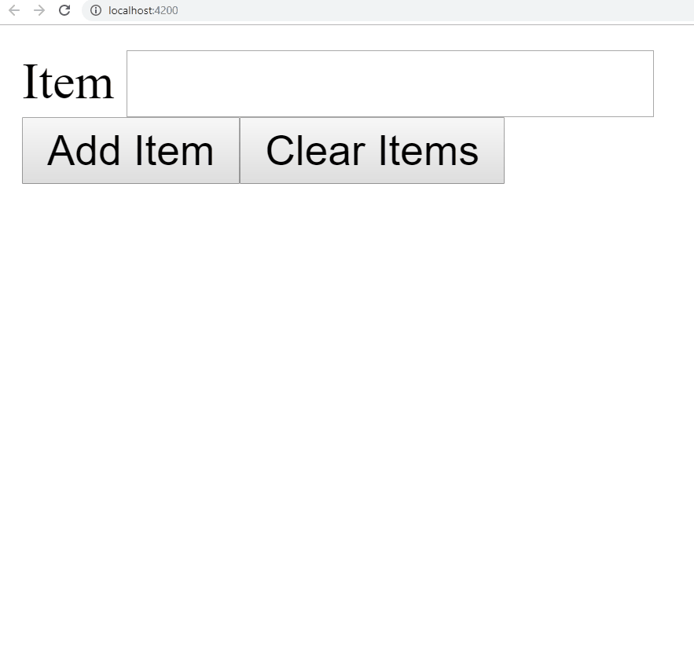
Question 3 (20) Marks
Write the simplest Angular code that is sufficient to produce the following output. You need to provide the source codes of app.component.html and app.component.ts only.
Start the Slide show
Note: More is less

